Slide 1
Docker 101

Slide 2
1. Introduction

Slide 3
The Birth of Docker
Solomon Hykes, CEO of dotCloud at Python Developers Conference in Santa Clara, California (March 15th 2013)
Available at GitHub
Huge amount of press
Promises to easily encapsulate the process of creating a distributable artifact for any application, deploying it at scale into any environment, and streamlining the workflow and responsiveness of agile software organizations.

Slide 4
The Promise of Docker
Viewed as a virtualization platform
Improving productivity
Docker sits right in the middle of some of the most enabling technologies of the last decade.
Combining the ease of application deployment and administrating virtualization systems

Slide 5
The Promise of Docker Benefits of the Docker Worflow

Slide 6
What Docker Ins’t

Slide 7
2. Docker at a Glance

Slide 8
Process Simplification

Slide 9
Broad Support and Adoption

Slide 10
Architecture
Client / Server Model
Network Ports and Unix Sockets
Robust Tooling
Docker Command-Line Tool
Application Programming Interface (API)
Container Networking

Slide 11
Getting the Most from Docker
Containers are not Virtual Machines
Containers are Lightweight
Towards an Immutable Infrastructure
Limited Isolation
Stateless Applications
Externalizing State

Slide 12
The Docker Workflow
Revision Control
Building
Testing
Packaging
Deploying
The Docker Ecosystem

Slide 13
Wrap-Up

Slide 14
3. Installing Docker

Slide 15
Important Terminology

Slide 16
Docker Client
Linux
Mac OS X 10.10
Microsoft Windows 8

Slide 17
Docker Server
Systemd-Based Linux
Upstart-Based Linux
init.d – Based Linux
Non-Linux VM Based Server

Slide 18
Test the Setup
Ubuntu
Fedora
CentOS

Slide 19
Wrap Up

Slide 20
6. Working with Docker Images

Slide 21
Anatomy of a Dockerfile

Slide 22
Building an Image

Slide 23
Running Your Image
Environment Variables

Slide 24
Custom Base Images

Slide 25
Storing Images
Public Registries
Private Registries
Authenticating to a Registry
Mirroring a Registry
Other Approaches to Image Delivery

Slide 26
7. Working with Docker Containers

Slide 27
What are Containers ?
History of Containers

Slide 28
Creating a Container
Basic Configuration
Storage Volumes
Resource Quotas

Slide 29
Starting a Container

Slide 30
Auto-Restarting a Container

Slide 31
Auto-Restarting a Container

Slide 32
Stopping a Container

Slide 33
Auto-Restarting a Container

Slide 34
Stopping a Container

Slide 35
Killing a Container

Slide 36
Pausing and Unpausing a Container

Slide 37
Cleaning Up Containers and Images

Slide 38
Next Steps

Slide 39
8. Exploring Docker

Slide 40
Printing the Docker Version

Slide 41
Server Information

Slide 42
Downloading Image Updates

Slide 43
Inspecting a Container

Slide 44
Getting Inside a Running Container
docker exec
nsenter

Slide 45
Exploring the Shell

Slide 46
Returning a Result

Slide 47
Docker logs

Slide 48
Monitoring Docker
Container Status
Docker Events
cAdvisor

Slide 49
9. The Path to Production Containers

Slide 50
Deploying
Classes of Tooling
Orchestration Tools
Distributed Schedulers
Deployment Wrap-Up

Slide 51
Testing Containers
Quick Overview
Outside Dependencies

Slide 52
10. Debugging Containers

Slide 53
Process Output

Slide 54
Process Inspection

Slide 55
Controlling Processes

Slide 56
Network Inspection

Slide 57
Image History

Slide 58
Inspecting a Container

Slide 59
Filesystem Inspection

Slide 60
Moving Along

Slide 61
11. Docker at Scale

Slide 62
Docker Swarm

Slide 63
Centurion

Slide 64
Amazon EC2 Container Service
IAM Role Setup
AWS CLI Setup
Container Instances
Tasks
Testing the Task
Stopping the Task

Slide 65
Wrap Up

Slide 66
12. Advanced Topics

Slide 67
Pluggable Backends
Execution Drivers
Storage

Slide 68
Containers in Detail
Control Groups (cgroups)
Kernel Namespaces, User Namespaces

Slide 69
Security
How Secure is your container ?
How Secure is the Docker Daemon ?

Slide 70
Networking

Slide 71
13. Designing your production container platform

Slide 72
The Twelve-Factor App
Codebase
Dependencies
Config
Backing Services
Build, Release, Run
Processes
Port Binding
Concurrency
Disposability
Development/Production Parity
Logs
Admin Processes
Twelve-Factor Wrap-Up

Slide 73
The Reactive Manifesto
Responsive
Resilient
Elastic
Message Driven

Slide 74
14. Conclusion

Slide 75
The Challenges

Slide 76
The Docker Workflow

Slide 77
Minimizing Deployment Artifacts

Slide 78
Optimizing Storage and Retrieval

Slide 79
The Payoff

Slide 80
The Final Word

Slide 81
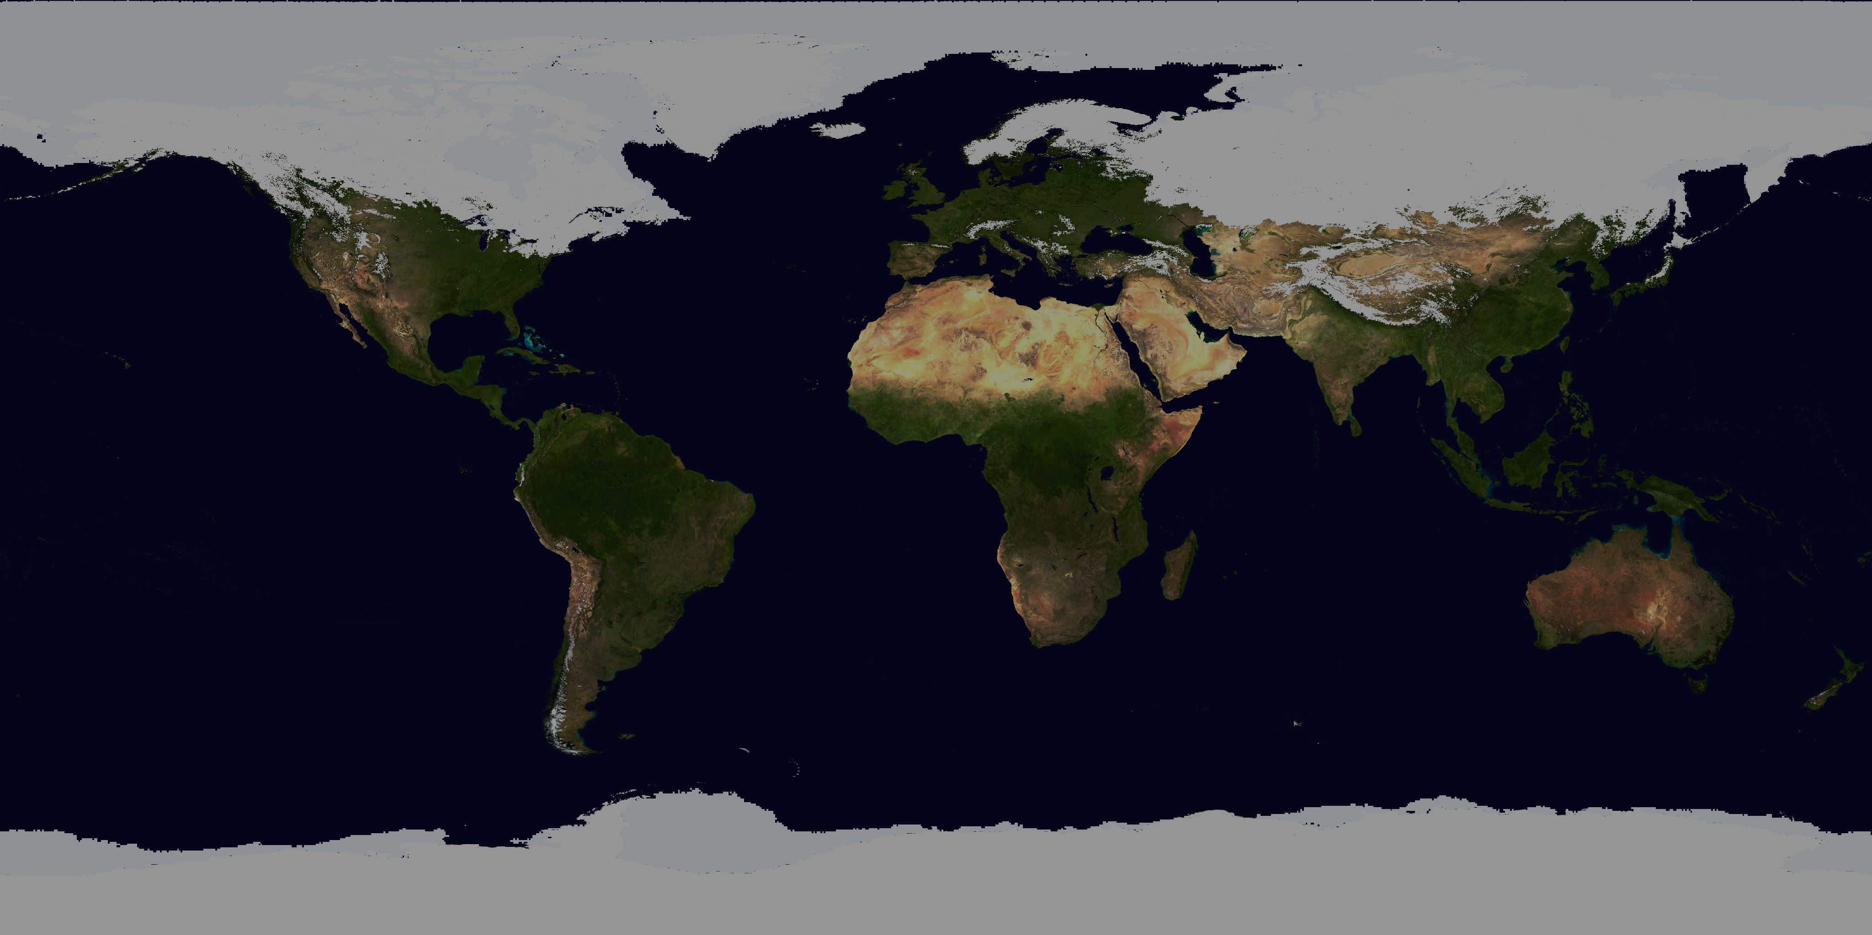
World population
2048
9 bin
2012
7 bin
2024
8 bin
1999
6 bin
1987
5 bin
1974
4 bin
1960
3 bin
1804
1 bin
1927
2 bin
1700
1800
1900
2000

Slide 82
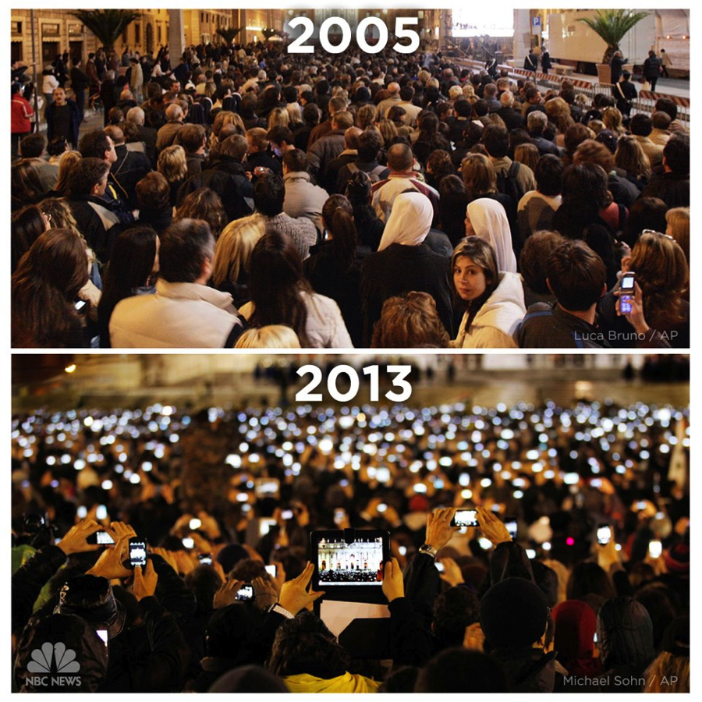

Slide 83
Growth of devices

Slide 84
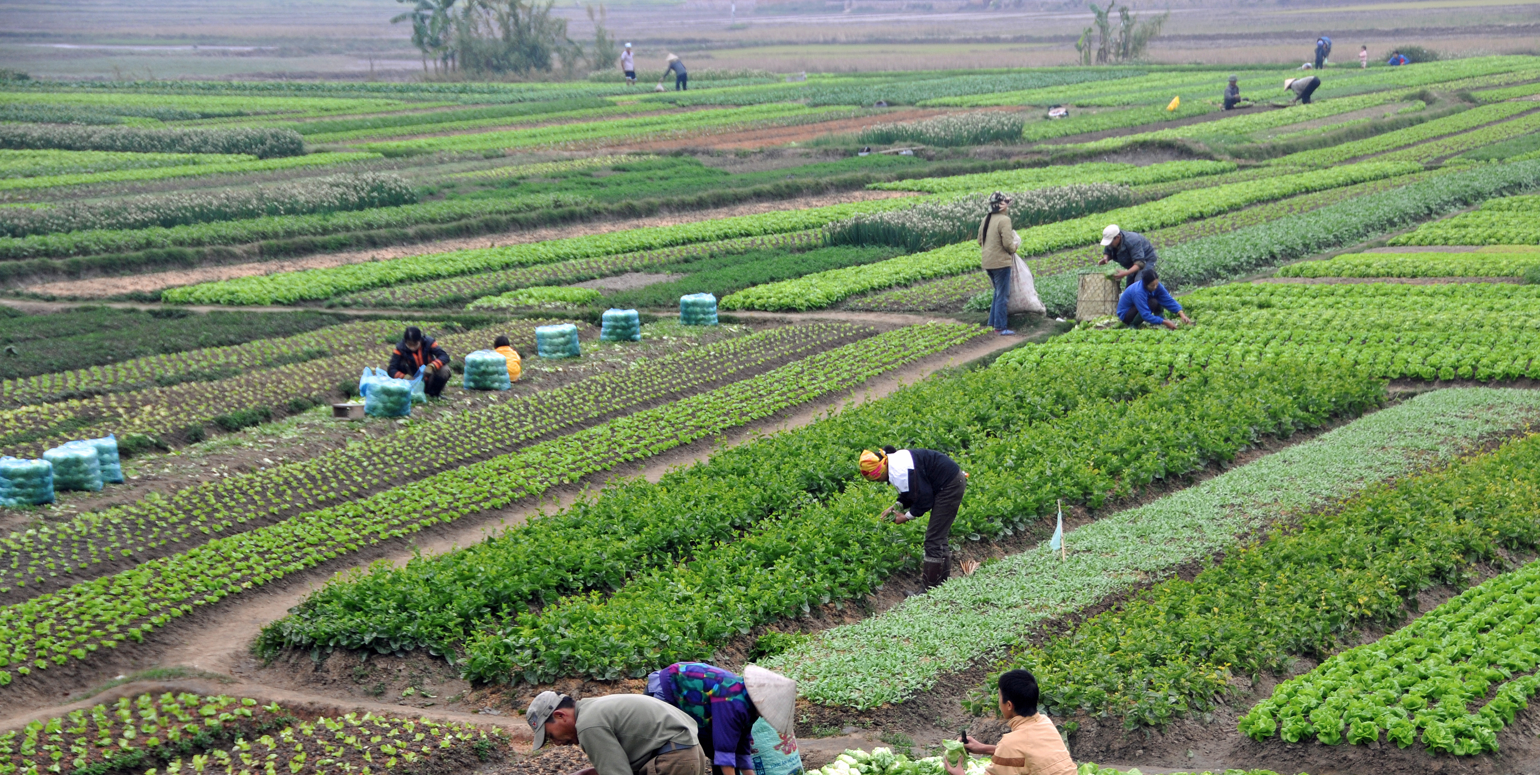
Agriculture

Slide 85
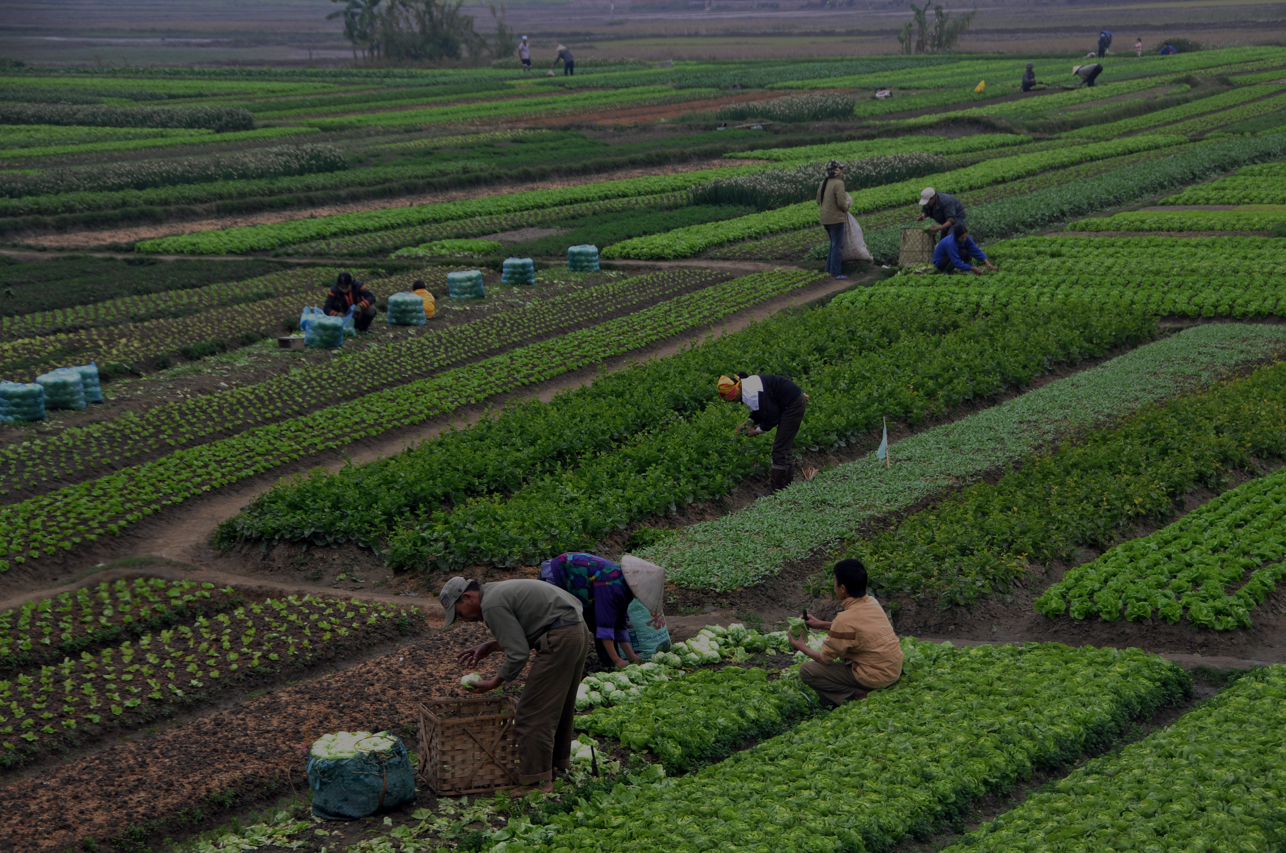
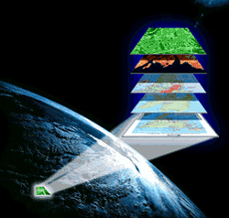
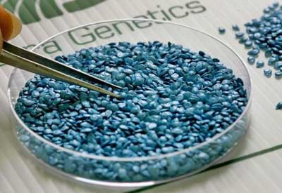
Agriculture: increase production
Satellite Imagery
Enhanced Seed Engineering

Slide 86

banking

Slide 87



banking: increase production
Transaction Processing
Identify, Sourcing, Pricing, Selling or Retaining Risk

Slide 88

transportation

Slide 89

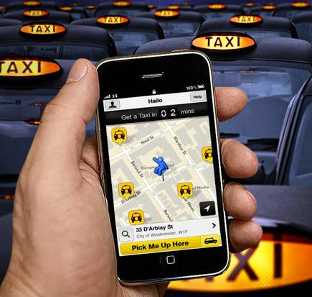
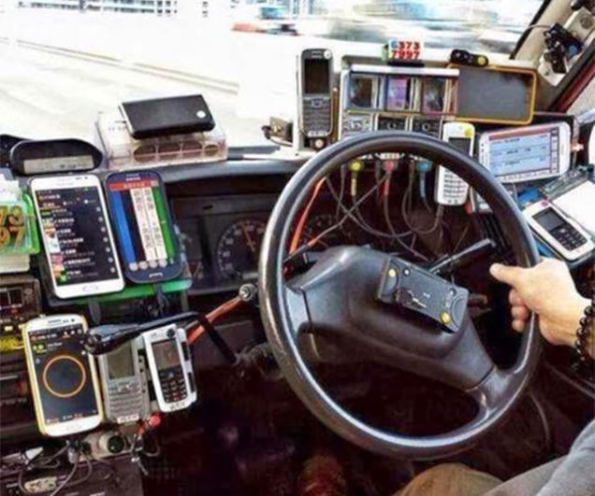
Taxi: better information
Finding the closest taxi
Finding the closest user

Slide 90
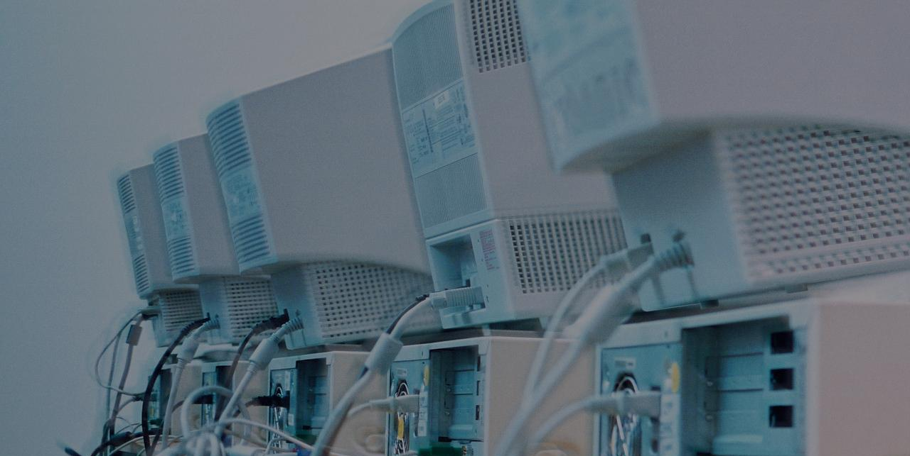
The evolution of it in businesses
The “IT” guy
IT Manager
C.T.O.
(Chief Technology Office)

Slide 91
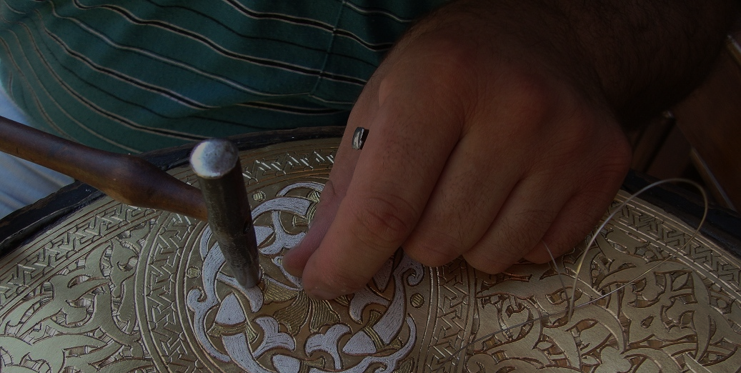
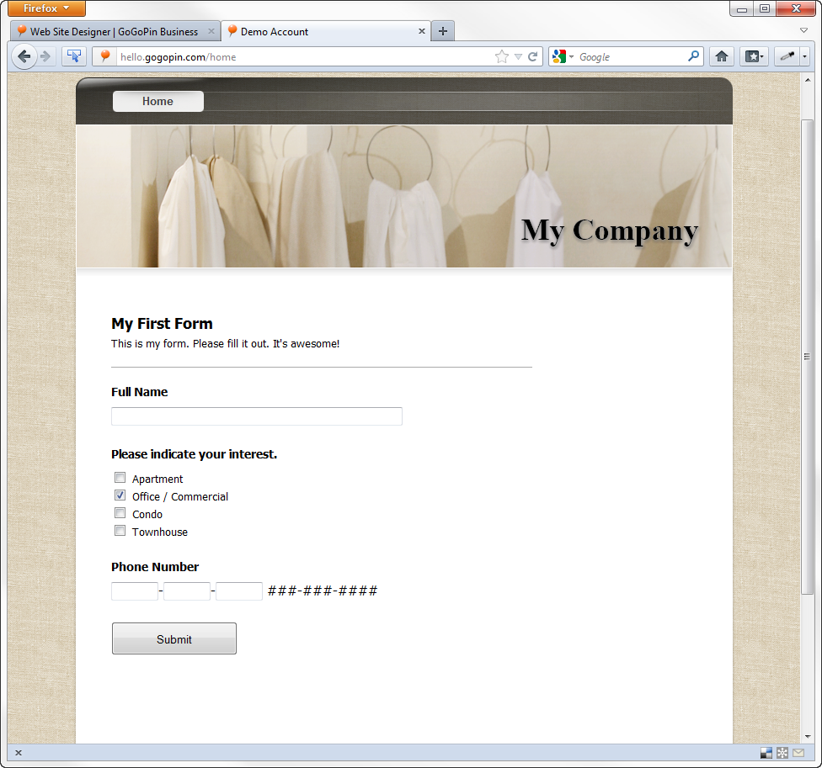
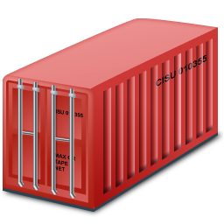


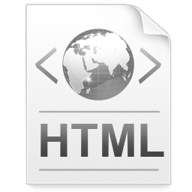
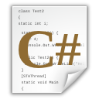
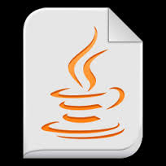
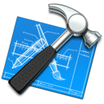
Traditional iT
Business
Operations
Development

Slide 92
Traditional iT
1 Deployment
(in production)
6 Months
(aprox)

Slide 93


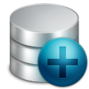

Traditional iT: development
Old Code
Pending Code
Monolith
Construction
New
Product
New Features

Slide 94


Traditional iT: development
Development Enviroment
Production Environment

Slide 95


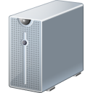


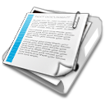
Traditional iT: operations
Constant Growing Number of Servers
Ineffective tooling to administer
Problems in releasing new code into production
Scheduling and burocreacy
Responsible for diagnose problems

Slide 96

The conflict
developers
operations

Slide 97

DEVOPS integrates developers and operations teams in order to improve collaboration and productivity by automating infrastructure, workflows and continuously measuring application performance.

Slide 98
Business
DevOps

Slide 99
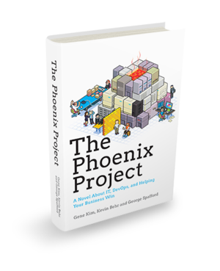
“Ops who thinks like Devs
Devs who thinks like Ops”
Gene Kim

Slide 100
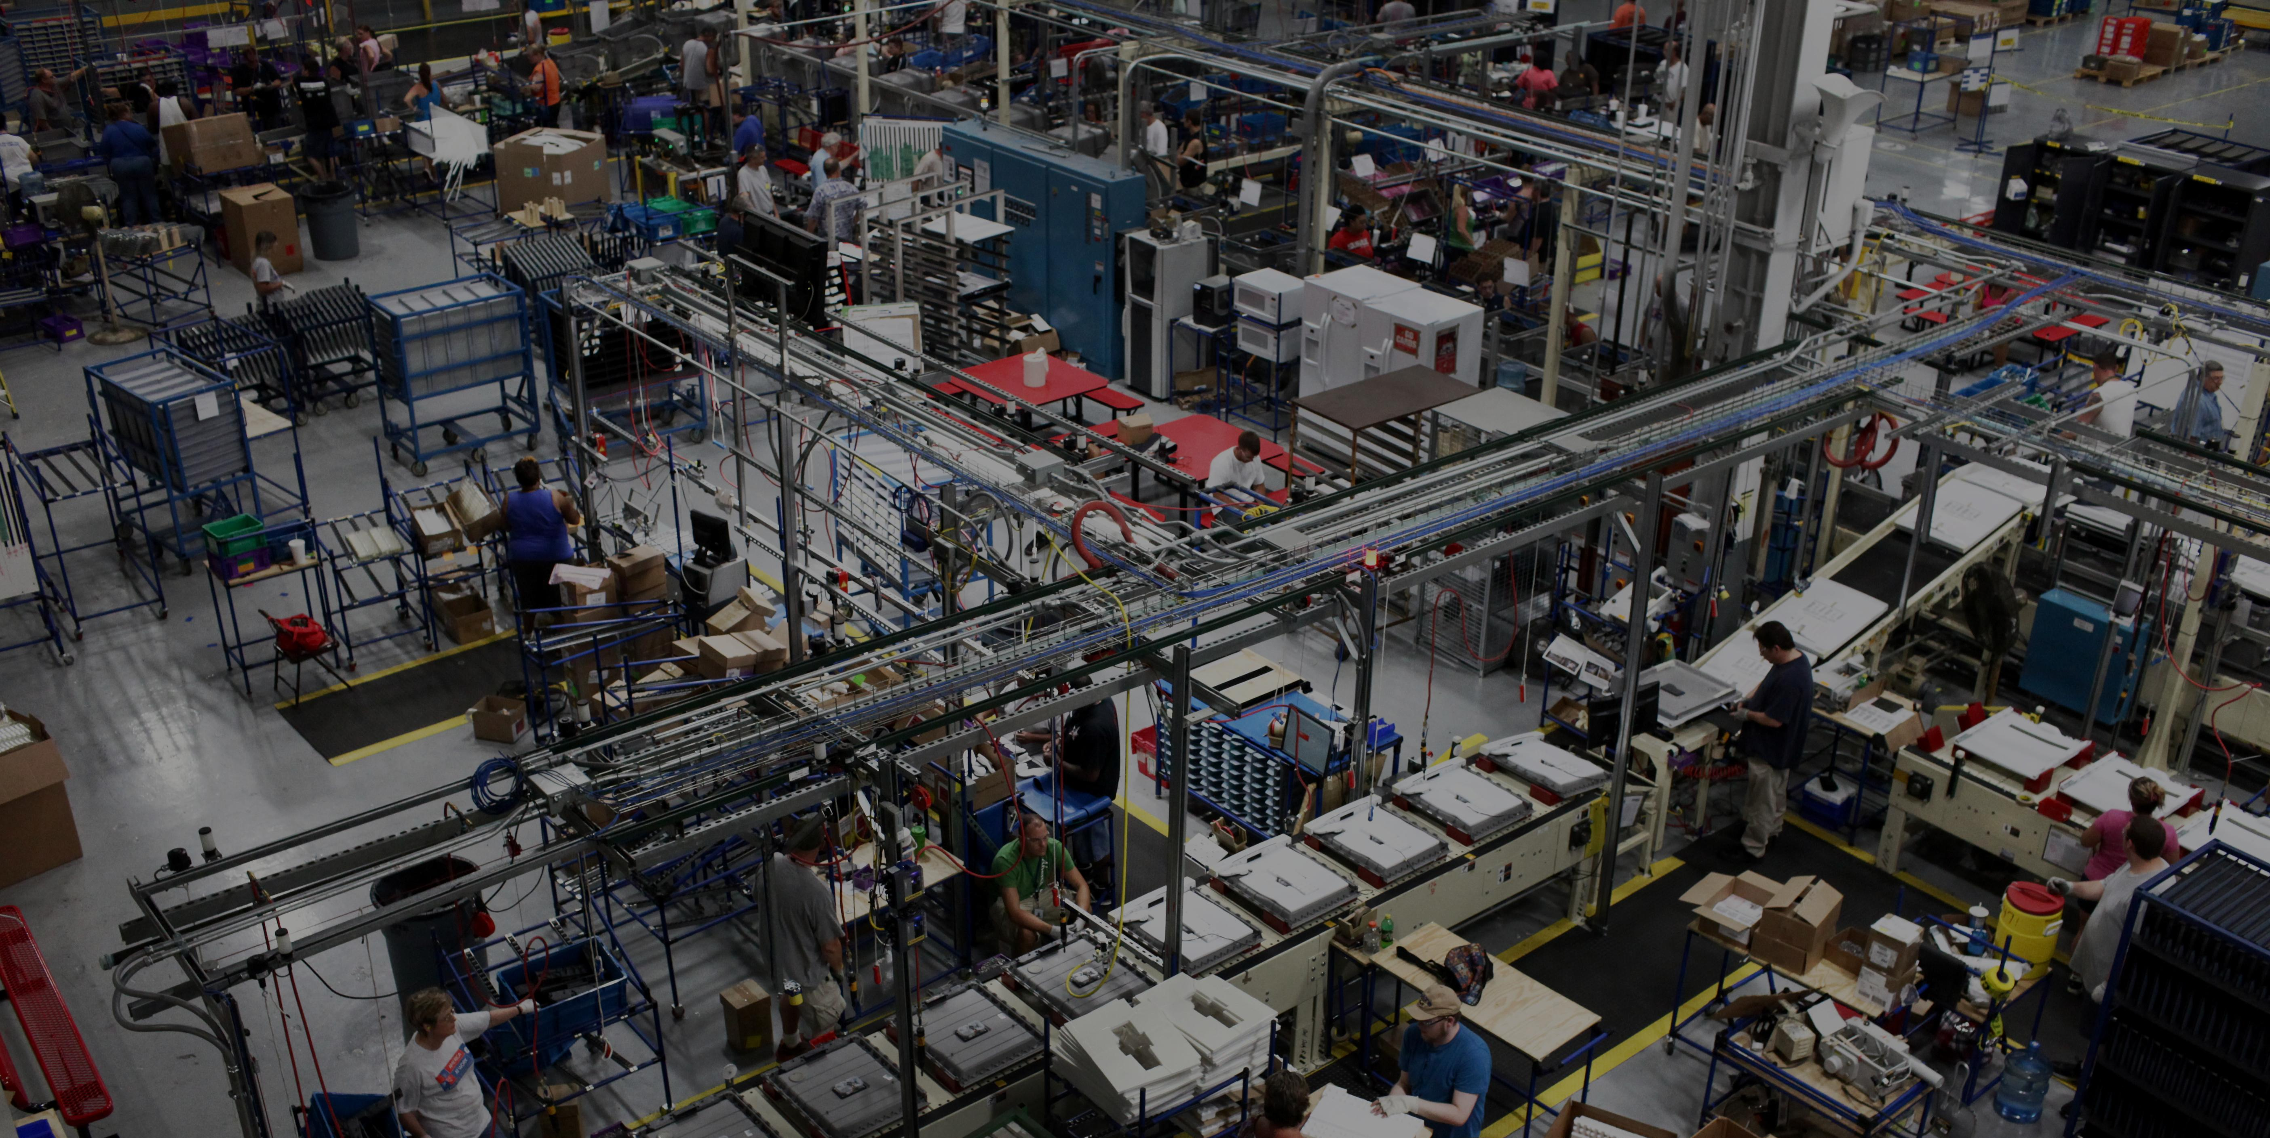

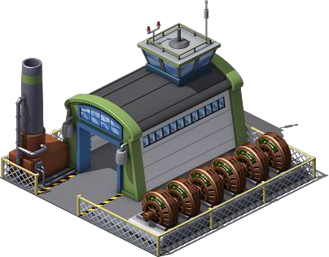
Devops: industrial it
Craftsmanship
Industrial

Slide 101



Devops components
Collaboration
of People
Convergence of Process
Creation & Exploitation of Tools

Slide 102
Devops component: People
Cultural Paradigm shift
Cross-training of skills
Collaboration and involvement of teams across all aspects of design.
Shared Responsibility.
Collaboration
of People
The question everyone should ask is “Is my application driving business value based on the state it is in now ?”

Slide 103
Devops component: process
Agile methodologies
Governance and continuous feedback loops to reduce/eliminate technical debt
Define metrics for measure
Inspired by Toyota Manufacturing Process.
Convergence of Process

Slide 104
Devops component: tool
Automation is key.
Standard environments: Development, Testing and Production.
Faster application environment provisioning, root cause analysis.
Creation & Exploitation of Tools
Continuous integration and delivering.

Slide 105
Devops: small chunks
JBoss
Monolith
Microservices

Slide 106
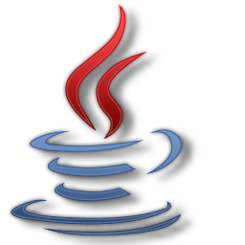

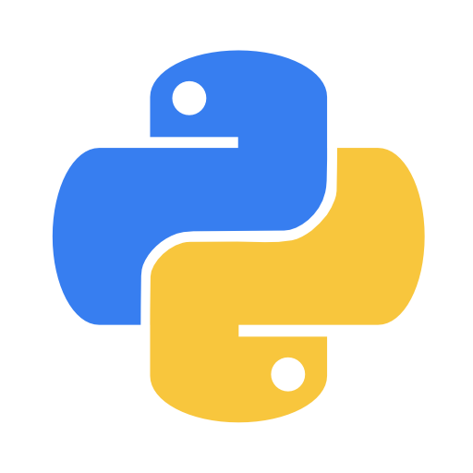

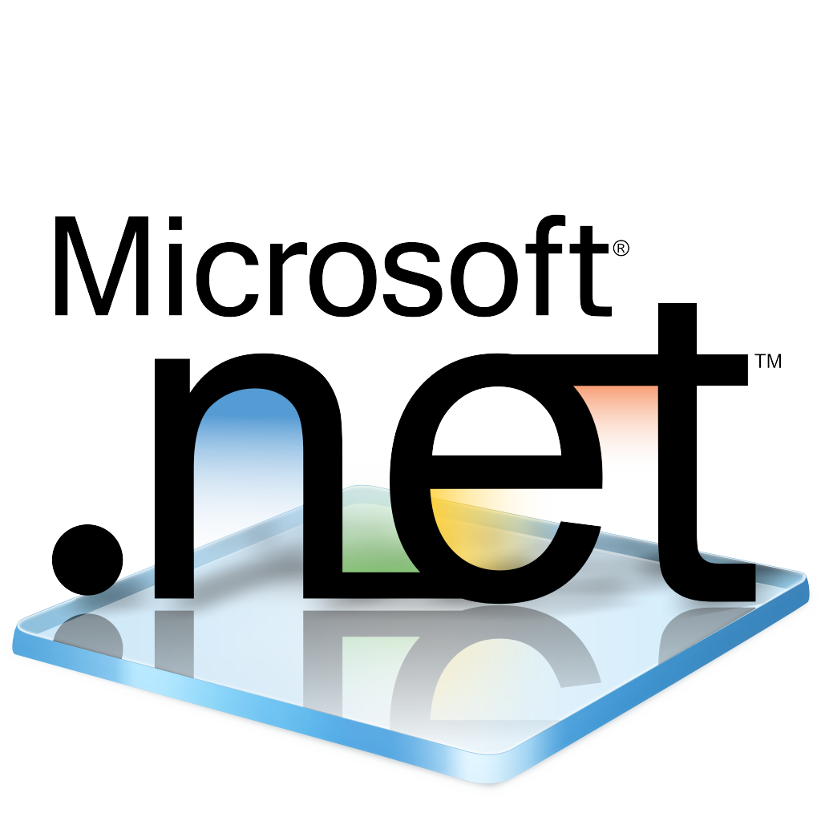
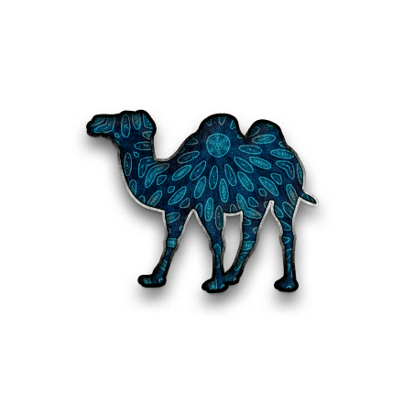


Devops: small chunks
java
8
senior
ruby
python
7
5.6.6
senior
middle
php
4.4.9
middle
.NET
perl
6
2.2.1
middle
junior
c
1.9.3
junior
Different languages
Different versions
Different
skills

Slide 107
Devops: small chunks
Speed of Deployment
Frequency of Deployments

Slide 108


Ability to respond to market needs
Testing
Improving
Monitor
Measuring

Slide 109


Faster Time-to-market
11.6
deployment/
second
1
1
deployment/
week
deployment/
month
1
deployment/
6 months

Slide 110
The goal
Rapid
Adaptation
Adaptative
Planning
Economic
Efficiency
Business
Agility
Focus on Time to Value
Low
Latency
Decoupling

Slide 111
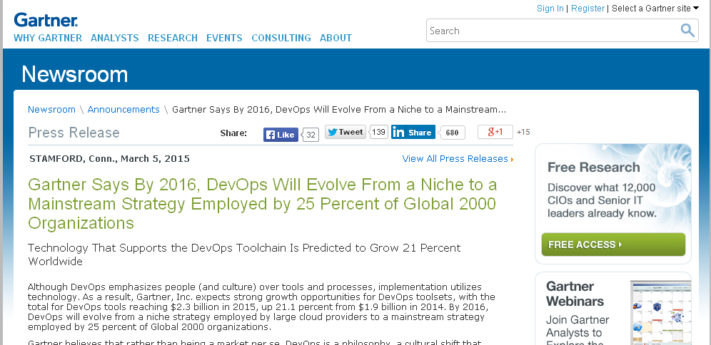
PRINTSCREEN GARTNER HERE
http://www.gartner.com/newsroom/id/2999017

Slide 112
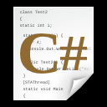
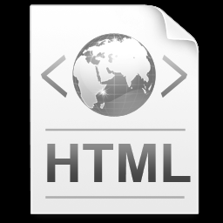


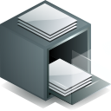
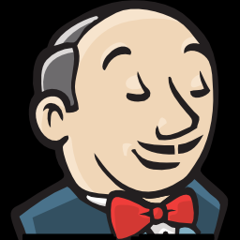


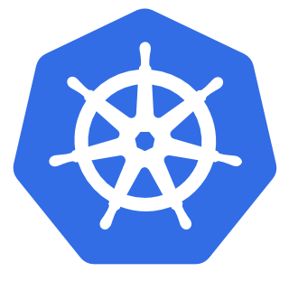
tooling
New Code
Analyze Results
GIT
Track all changes
Monitor
Testing Code
Containers
Host Factory

Slide 113
tooling
OpenShift

Slide 114

Howto: DEVelopment
OpenShift

Slide 115
District: DEV
REQUEST
New Code

Slide 116
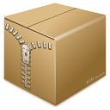
District: DEV
JBoss
http://myapp-hello.company.com
JBoss
(aprox 1 minute)
Configuration
ready
myapp-hello

Slide 117
District: DEV
JBoss
GIT PUSH
JBoss
Code Ready
myapp-hello
GIT

Slide 118

District: DEV
District: PROD
JBoss
JBoss
myapp-hello
myapp-hello
GIT
TEST PASSED

Slide 119
Howto: production
OpenShift

Slide 120
District: PROD
JBoss
http://myapp-hello.company.com
myapp-hello

Slide 121
District: PROD
JBoss
http://myapp-hello.company.com
myapp-hello

Slide 122
District: PROD
JBoss
RESPONSE: {“id”,”2”;”name”,”maltron”}
myapp-hello

Slide 123
District: PROD
JBoss
http://myapp-hello.company.com
myapp-hello

Slide 124
Scaling out
District: PROD
JBoss
JBoss
http://myapp-hello.company.com
myapp-hello

Slide 125
District: PROD
JBoss
JBoss
RESPONSE: {“id”,”2”;”name”,”maltron”}
myapp-hello

Slide 126
SCALing IN
District: PROD
JBoss
JBoss
http://myapp-hello.company.com
myapp-hello

Slide 127
District: PROD
JBoss
http://myapp-hello.company.com
myapp-hello

Slide 128
District: PROD
JBoss
RESPONSE: {“id”,”2”;”name”,”maltron”}
myapp-hello

Slide 129

Devops formula
New Tools
Change in Mindset

Slide 130
Red hat subscription
Legal Protection
Operation Man. Tool
Long-term Support
World Class Support
Knowledge Base
Security Patch
Change in Mindset

Slide 131

Red hat devops solution
Legal Protection
Operation Man. Tool
Long-term Support
assessment
World Class Support
consulting
Knowledge Base
Security Patch
mentoring
trainning
setup
discover
planning
architecture
building
monitoring
Professional Services

Slide 132



Professional services
Discovery Session
Workshops
Assessments
Implementation Sprints

